Slide 1
Computer Vision
Dr.U.Samson Ebenezar

Slide 2
What Is Computer Vision?
Computer vision is the ability of computers to understand and analyze visual content in the same way humans do. This includes tasks such as recognizing objects and faces, reading text and understanding the context of an image or video.
Computer vision is closely related to artificial intelligence (AI) and often uses AI techniques such as machine learning to analyze and understand visual data. Machine learning algorithms are used to “train” a computer to recognize patterns and features in visual data, such as edges, shapes and colors.

Slide 3
Cont..
Once trained, the computer can use this knowledge to identify and classify objects in new images and videos. The accuracy of these classifications can be improved over time through further training and exposure to more data.
In addition to machine learning, computer vision may also use techniques such as deep learning, which involves training artificial neural networks on large amounts of data to recognize patterns and features in a way that is similar to how the human brain works.

Slide 4
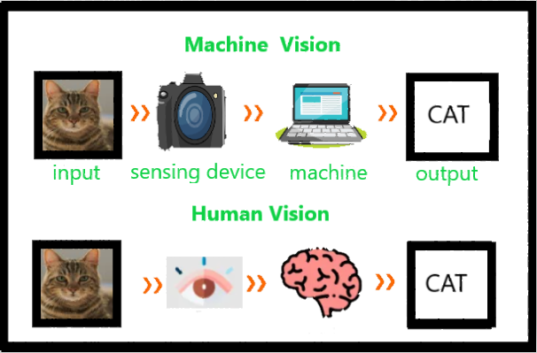

Slide 5
Computer vision means the extraction of information from images, text, videos, etc. Sometimes computer vision tries to mimic human vision. It’s a subset of computer-based intelligence or Artificial intelligence which collects information from digital images or videos and analyze them to define the attributes.
The entire process involves image acquiring, screening, analyzing, identifying, and extracting information.
This extensive processing helps computers to understand any visual content and act on it accordingly.
Computer vision projects translate digital visual content into precise descriptions to gather multi-dimensional data.
This data is then turned into a computer-readable language to aid the decision-making process.
The main objective of this branch of Artificial intelligence is to teach machines to collect information from images.

Slide 6
Cont..
Pixel Extraction
OpenCV (Open Source Computer Vision), a cross- platform and free to use library of functions is based on real time Computer Vision which supports Deep Learning frameworks that aids in image and video processing. In Computer Vision, the principal element is to extract the pixels from the image so as to study the objects and thus understand what it contains. Below are a few key aspects that Computer Vision seeks to recognize in the photographs:
Object Detection: The location of the object.
Object Recognition: The objects in the image, and their positions.
Object Classification: The broad category that the object lies in.
Object Segmentation: The pixels belonging to that object.

Slide 7
Applications and Future
Computer Vision covers a huge ground as its applications know no bounds. It often escapes our minds as we fail to notice the role Computer Vision plays in the gadgets, we use day in and day out.
Smartphones and Web: Google Lens, QR Codes, Snapchat filters (face tracking), Night Sight, Face and Expression Detection, Lens Blur, Portrait mode, Google Photos (Face, Object and scene recognition), Google Maps (Image Stitching).
Medical Imaging: CAT/MRI
Insurance: Property Inspection and Damage analysis
Optical Character Recognition (OCR)
3D Model Building (Photogrammetry)
Merging CGI with live actors in movies

Slide 8
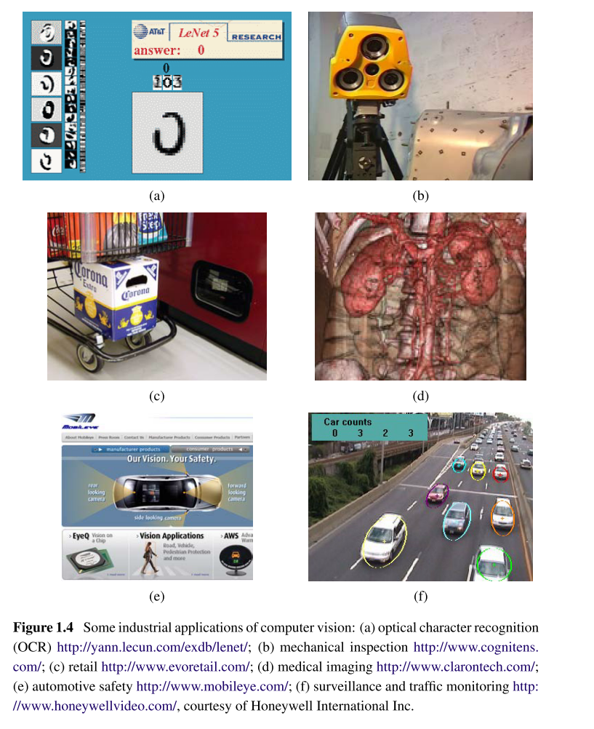
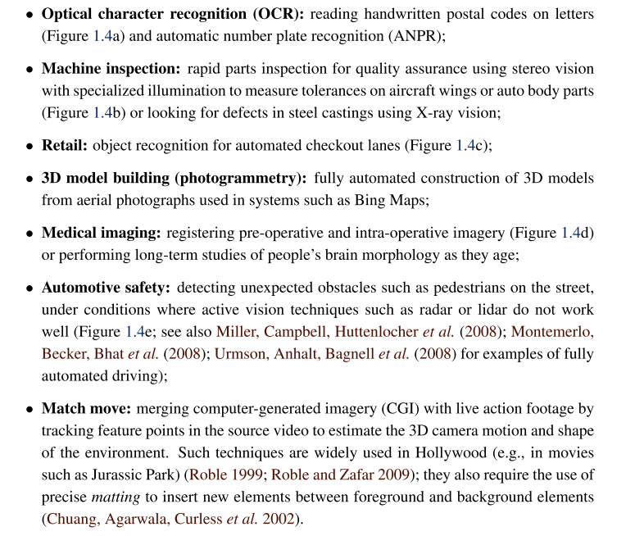

Slide 9
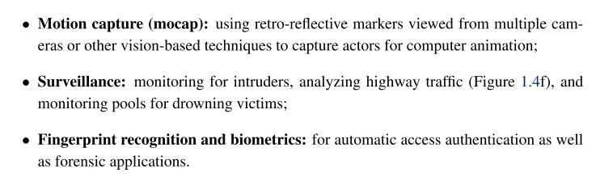
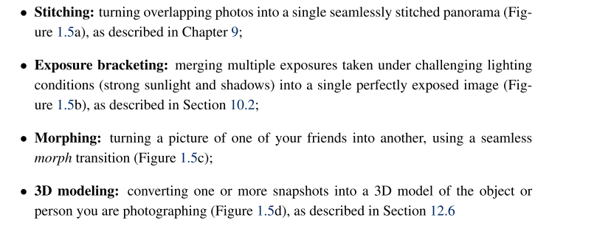

Slide 10
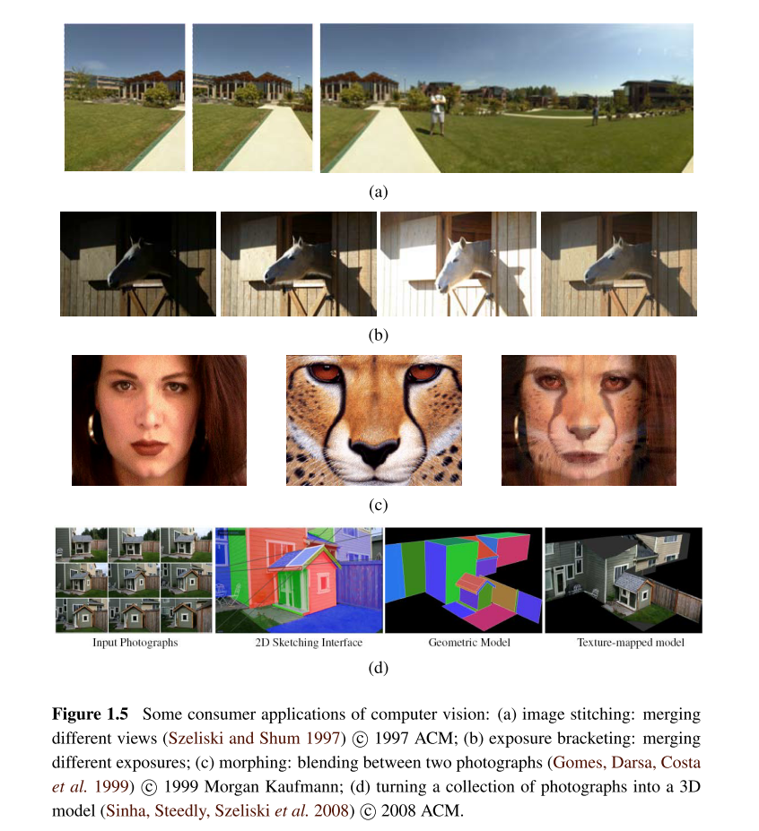
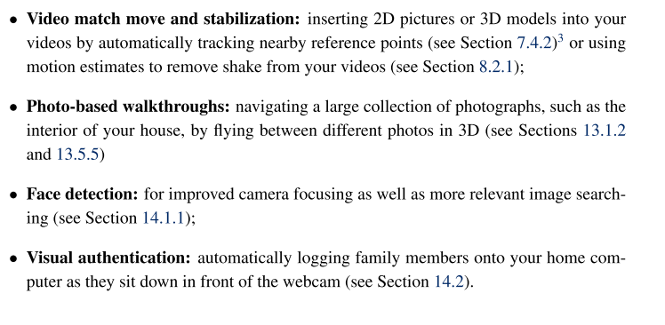

Slide 11
Features of Computer Vision
In computer vision and image processing, a feature is a piece of information about the content of an image; typically about whether a certain region of the image has certain properties.
Features may be specific structures in the image such as points, edges or objects.
Features may also be the result of a general neighborhood operation or feature detection applied to the image.
Other examples of features are related to motion in image sequences, or to shapes defined in terms of curves or boundaries between different image regions.
A feature is any piece of information that is relevant for solving the computational task related to a certain application.

Slide 12
Features of Computer Vision
Features are often distinct patterns, such as edges, corners, textures, or specific shapes, that algorithms use to understand and analyze visual data.
For example, in a photo of a car, features might include the edges of the windshield, the corners of the license plate, or the texture of the tires. These features help reduce the complexity of raw pixel data by focusing on key elements that are relevant to solving a problem.
By extracting and comparing features, algorithms can recognize objects, match images, or detect changes across frames in a video.

Slide 13
Features of Computer Vision
Traditional feature extraction methods rely on mathematical techniques to identify and describe these key points.
Algorithms like SIFT (Scale-Invariant Feature Transform) or ORB (Oriented FAST and Rotated BRIEF) detect stable features by analyzing gradients, corners, or blobs in an image.
For instance, SIFT identifies features that remain consistent even if the image is scaled or rotated, making it useful for tasks like panorama stitching. Once detected, features are often represented as numerical vectors (descriptors) that encode their visual properties.
These descriptors allow algorithms to compare features across images efficiently—like matching keypoints between two photos of the same scene taken from different angles. However, these methods require manual tuning and may struggle with complex or noisy data, such as low-light images or occluded objects.

Slide 14
Features of Computer Vision
Modern approaches, particularly deep learning, automate feature extraction using convolutional neural networks (CNNs).
In CNNs, layers learn hierarchical features directly from data. Early layers detect simple patterns like edges or color gradients, while deeper layers combine these to recognize complex shapes or objects.
For example, a CNN trained on animal images might learn to detect eyes or fur textures as intermediate features. This data-driven approach eliminates the need for handcrafted feature design and adapts to diverse scenarios, from medical imaging to autonomous driving.
Libraries like PyTorch or TensorFlow provide pre-trained models (e.g., ResNet) that developers can fine-tune for specific tasks, leveraging learned features without starting from scratch. While computationally intensive, this method often outperforms traditional techniques in accuracy and scalability for large datasets.

Slide 15
Features of Computer Vision
Feature Vector
Definition:
A feature vector is a list (or array) of numerical values that represent characteristics (features) of an object (e.g., an image, a face, a sound clip, etc.) in a format suitable for machine learning or computer vision models.
Key Points:
• It is a compact representation of an object.
• Each element in the vector corresponds to a specific feature (e.g., color, shape, texture).
• Feature vectors allow algorithms to compare, classify, or cluster inputs.
Examples:
• Average color values (RGB)
• Texture descriptors (e.g., Local Binary Pattern - LBP)
• Edge histograms
• Deep learning features (e.g., 2048-d vector from CNNs)
Example (face image feature vector):
[0.21, 0.65, 0.87, 0.34, ..., 0.45] ← could be 128 or 512 dimensions.

Slide 16
Features of Computer Vision
🔷 Feature Space
• Definition:
The feature space is the multi-dimensional space formed by all possible combinations of features from the feature vectors. Each object is represented as a point in this space.
• Key Points:
• Each axis in the space corresponds to one feature.
• Similar objects lie closer; different ones are farther apart.
• Useful in classification, clustering, and similarity search.
• Examples:
• In 2D feature space: (Color Intensity, Texture)
• In face recognition: 128D feature space from deep learning

Slide 17
Features of Computer Vision

Slide 18
Features of Computer Vision

Slide 19
Levels of Computer Vision and Image processing
Level | Focus | Key Methods/Tools | Example Task
Low-Level | Pixels | Filtering, thresholding, noise removal | Denoising an image
Mid-Level | Regions/Structures | Feature extraction, segmentation | Extracting objects from background
High-Level | Semantic Understanding | CNNs, Object Detection, Recognition | Face recognition, scene classification

Slide 20
Levels of Computer Vision and Image processing
1. Low-Level Processing (Image Processing)
Key Points:
Focuses on pixel-level operations
Enhances image quality
No understanding of content
Typically mathematical and algorithmic
Techniques:
•Image filtering (e.g., Gaussian blur)
• Contrast enhancement
• Noise reduction
• Edge detection (e.g., Sobel, Canny)
• Thresholding (binary images)
Examples:
• Removing noise from a medical scan
• Enhancing satellite images
• Detecting edges in road sign images for autonomous driving

Slide 24
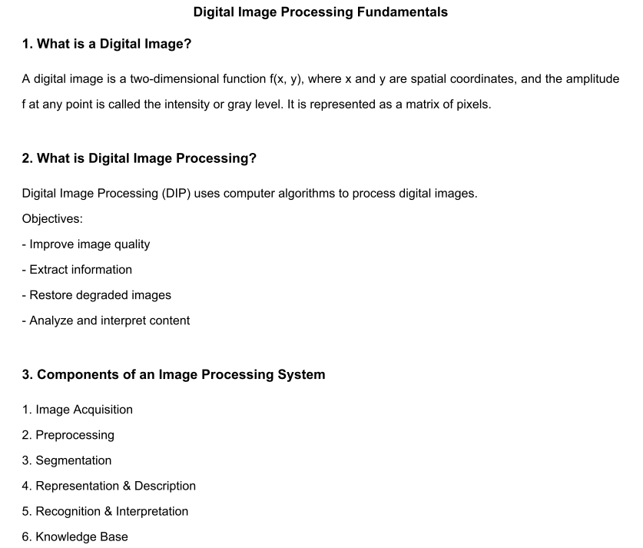

Slide 25
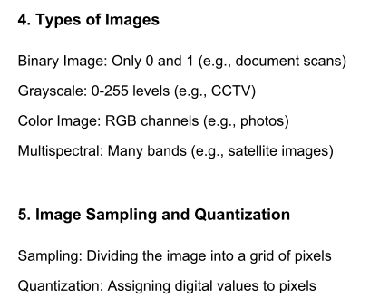
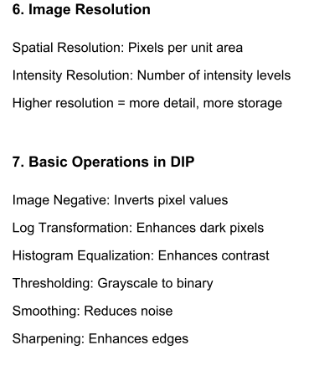
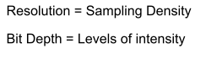

Slide 26
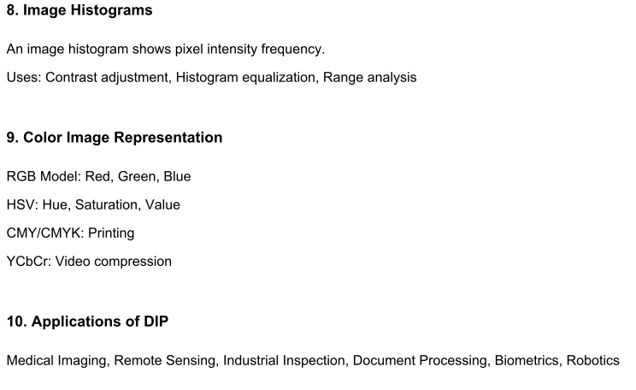

Slide 27
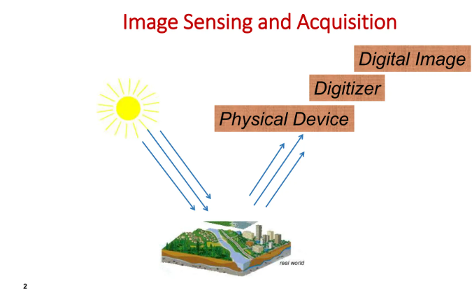
Image sensing and Acquisition

Slide 28
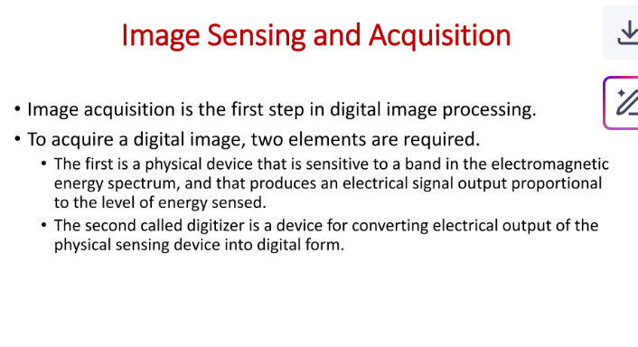
Image sensing and Acquisition

Slide 29
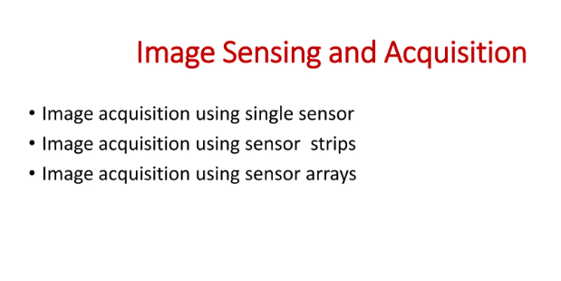

Slide 30
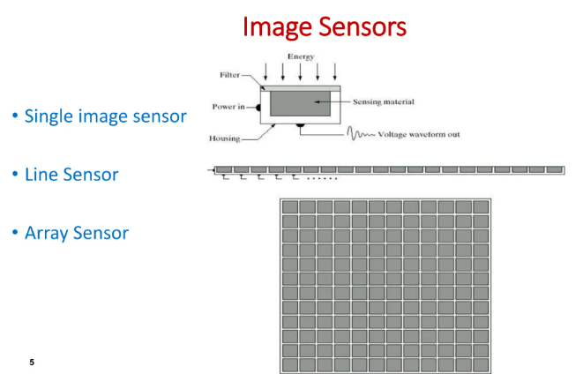

Slide 31
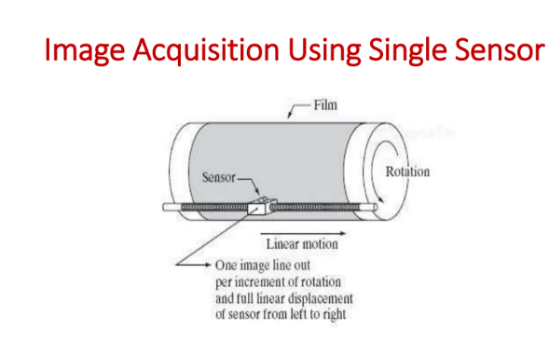

Slide 32
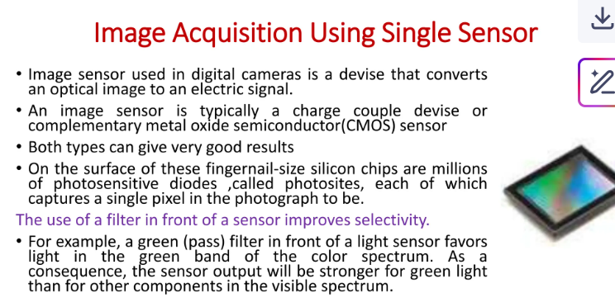

Slide 33
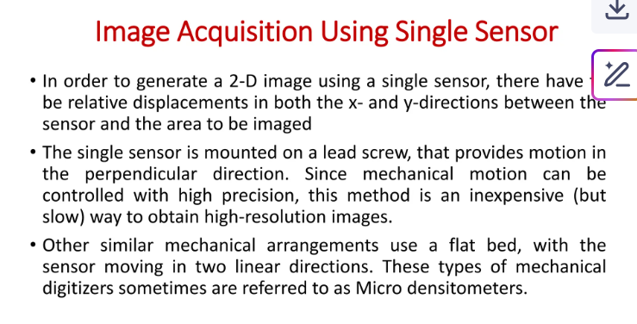

Slide 34
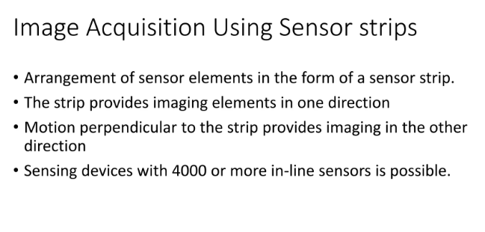

Slide 35
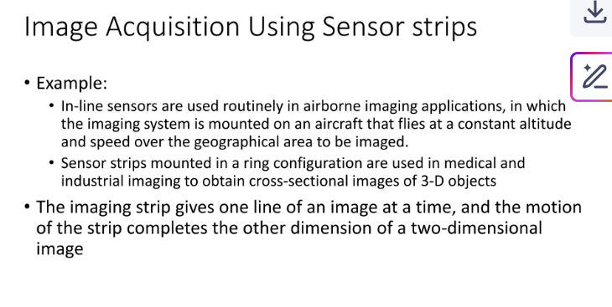

Slide 36
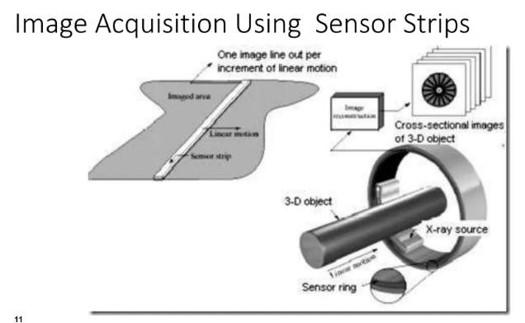

Slide 37
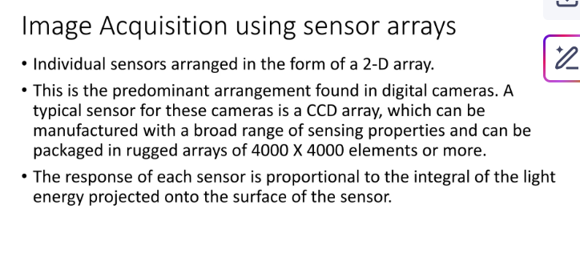

Slide 38
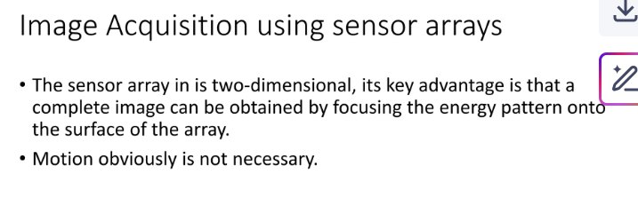

Slide 39
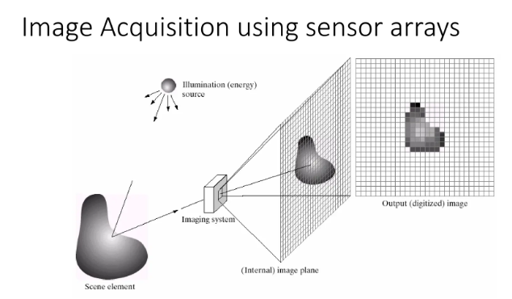

Slide 40
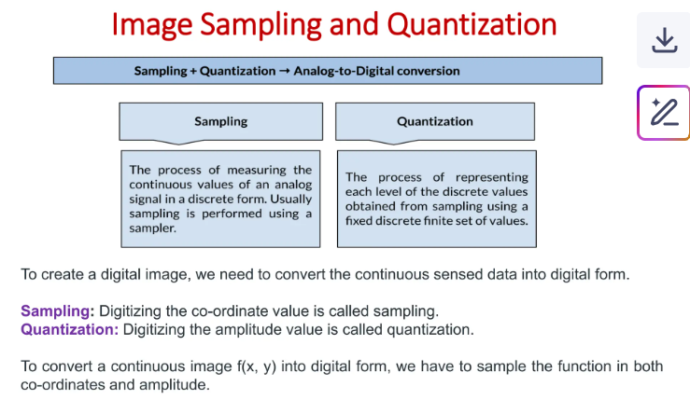

Slide 41
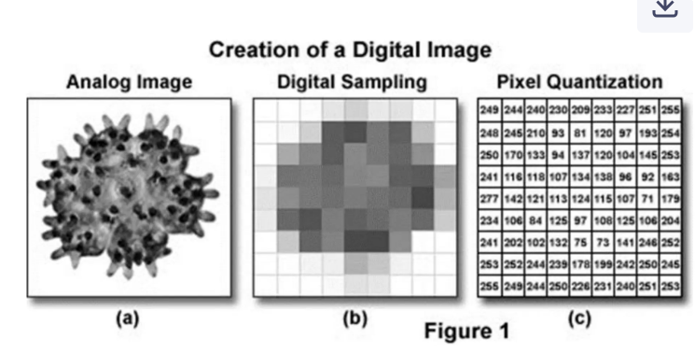

Slide 42
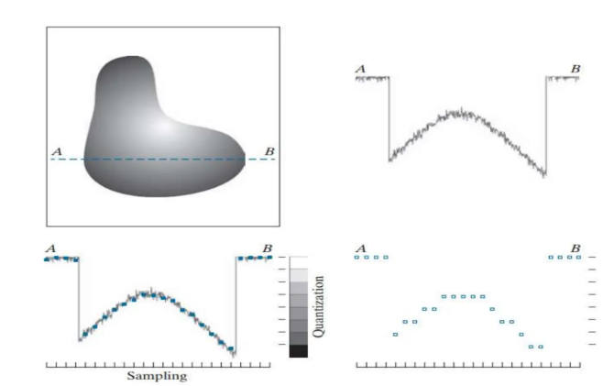

Slide 43
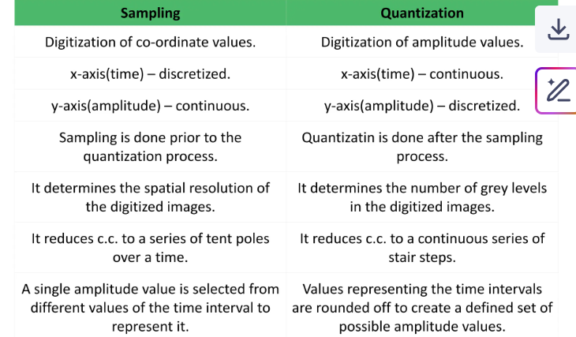

Slide 44
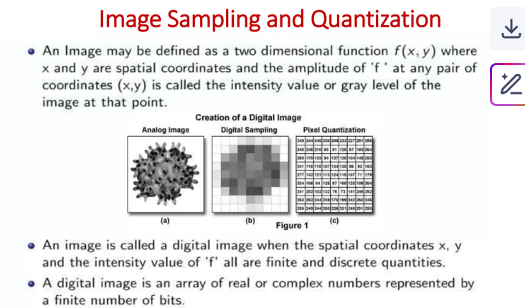

Slide 45
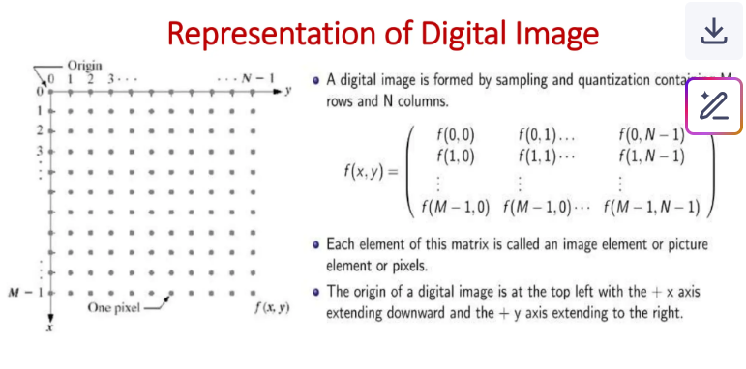

Slide 46
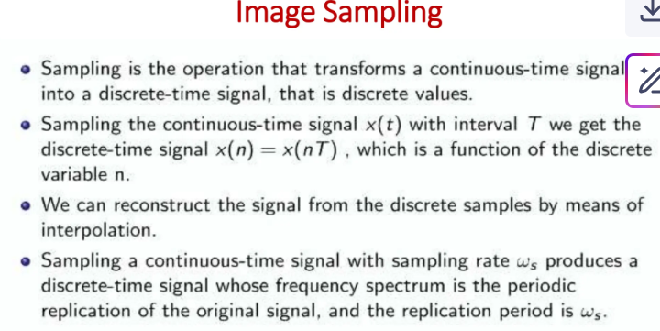

Slide 47
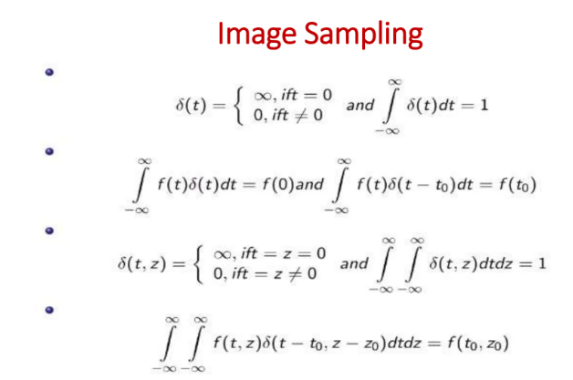

Slide 48
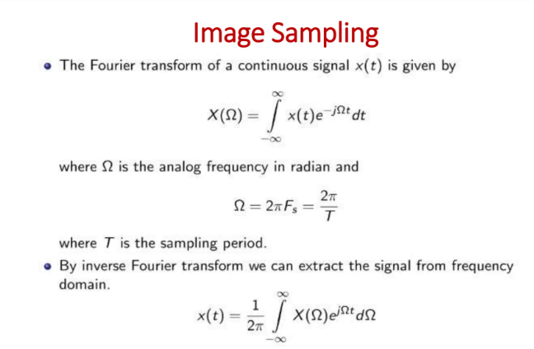

Slide 49
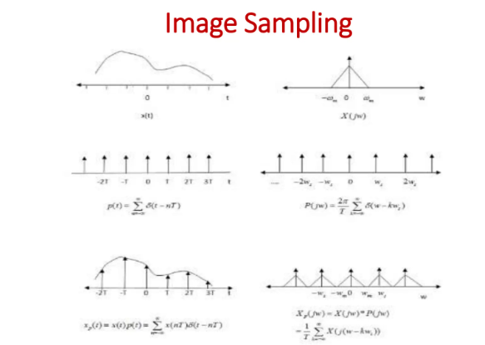

Slide 50
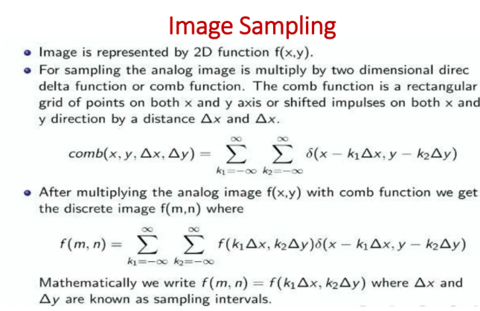

Slide 51
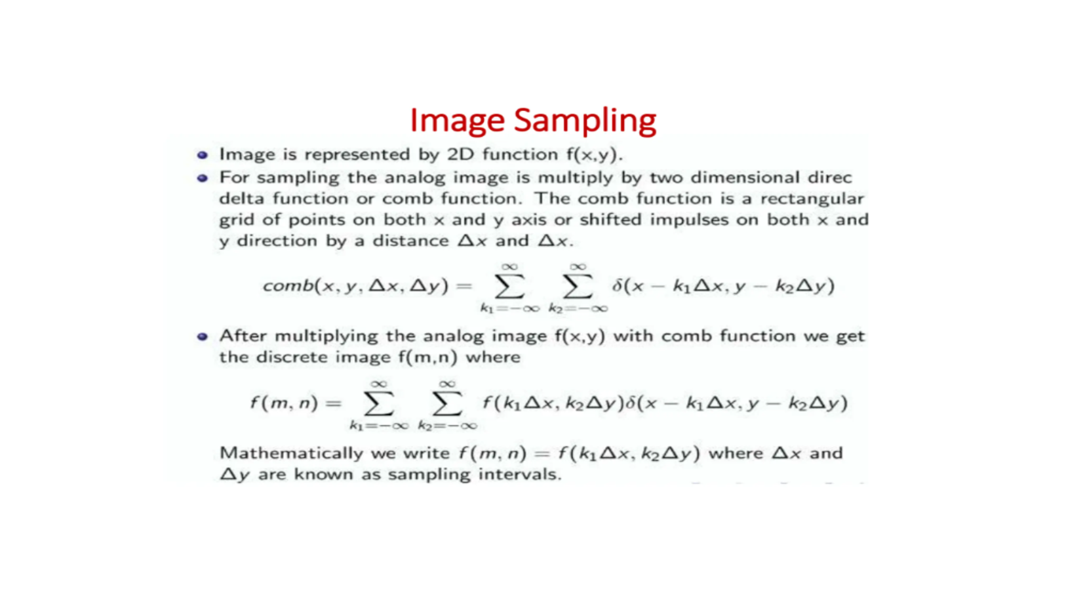

Slide 52
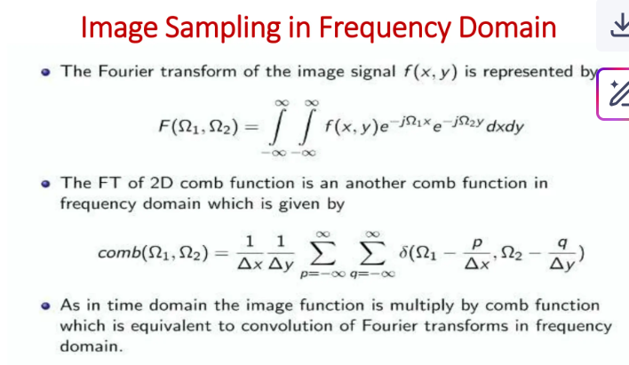

Slide 53
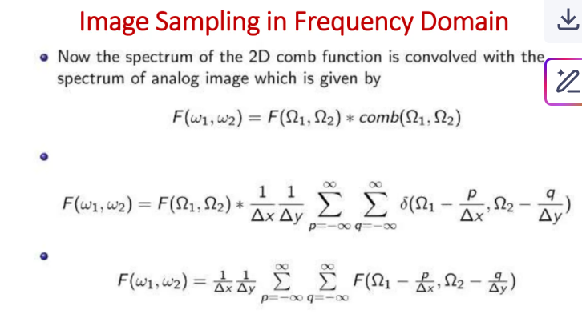

Slide 54
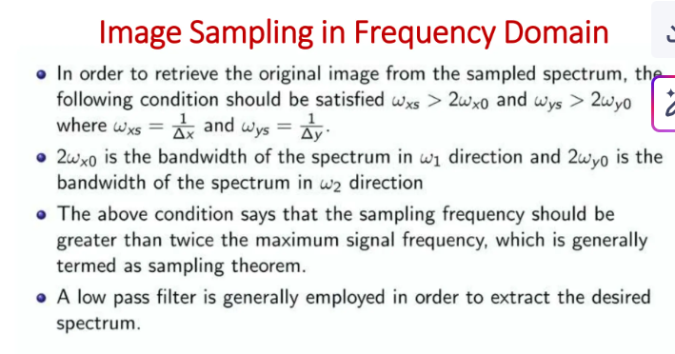

Slide 55
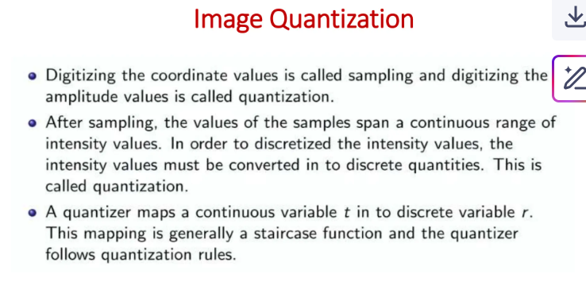

Slide 56
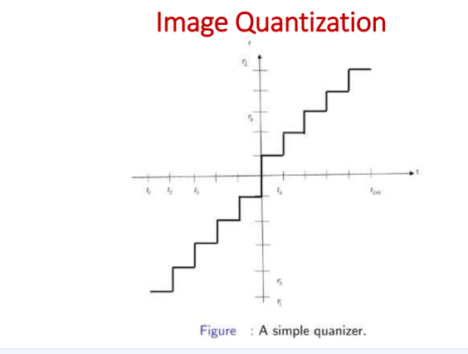

Slide 57
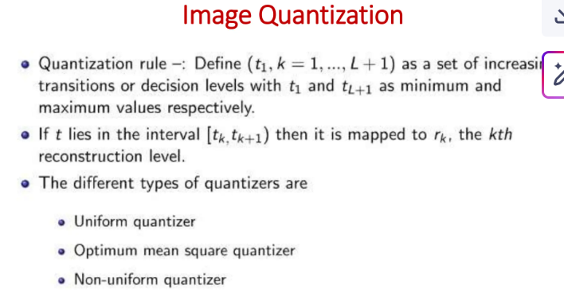

Slide 58
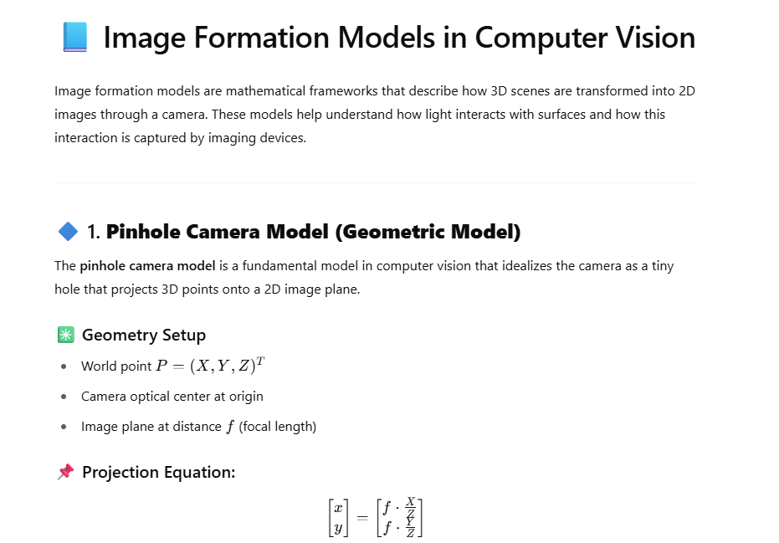
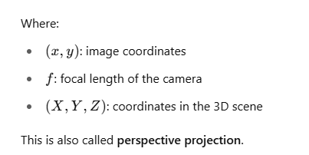

Slide 59
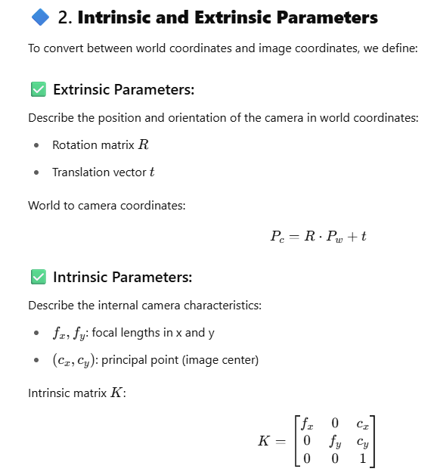
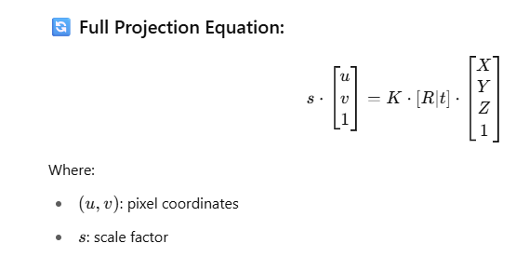

Slide 60
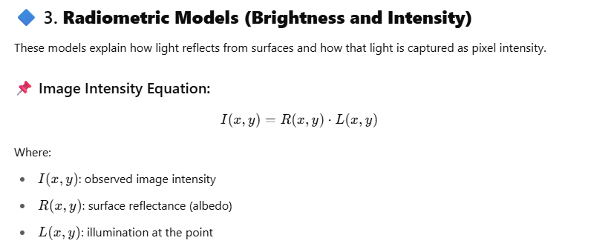
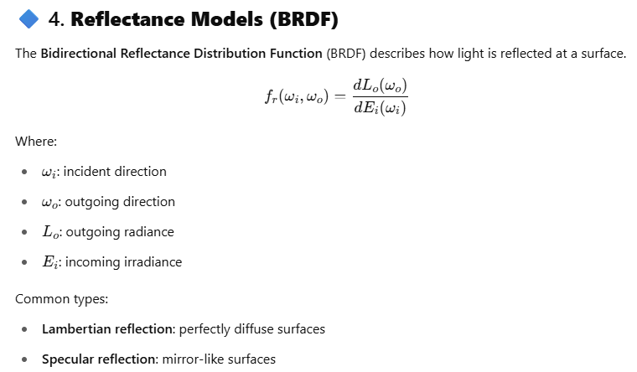

Slide 61
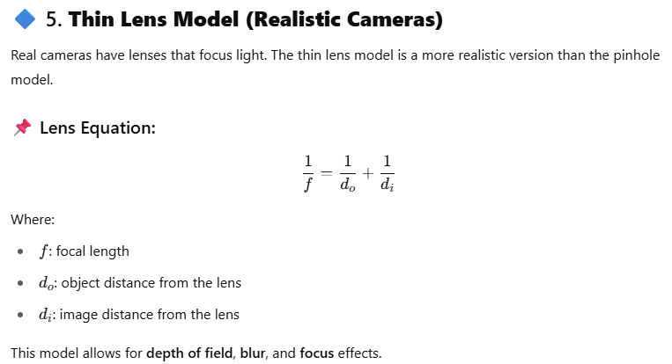


Slide 62


Slide 63


